Slide 1
Phase 3: Plotting and Ballistic Trajectory
Charlie
Lt David Crow
Lt Savannah Hyde
Lt Ahmed King

Slide 2
Group Steps to Complete Deliverable
Enumerate steps taken by group to accomplish deliverable
David: Implemented ribbon, restructured/helped with plots, and integrated/cleaned code
Savannah: Plotted predicted path and allowed for dynamic sensor placement
Ahmed: Instantiated Gnuplot and plotted observed path
Issues
Thanksgiving break
PolyFit
Notes:
Enumerate steps taken by group to accomplish deliverable
Who did what?
What issues arose based on preliminary plan?

Slide 3
Design Decisions
Software quality attributes
Testability: Ensured each teammate had repeatable results; tested missiles and graphs from multiple angles
Maintainability and Reusability: Assumed Phase 3 is reused for Phase 4; ensured all decisions were justifiable to build on
Design patterns
Aggregation: GLViewDefenseDaemon has a GNUPlot; WOInterceptorMissile has a WOTrackingRibbonBase
Notes:
Justify your Software Quality Attributes
Convince me why your design decisions are fundamentally sound from a Software Engineering perspective.
Pros / Cons of decisions
There is no “perfect” answer, every decision is a tradeoff between one or more competing attributes
Which Software Quality Attributes did you prioritize first?
What Patterns did your group employ? Why?

Slide 4
Lessons Learned
What worked?
The ribbon
Gnuplot
PolyFit….. eventually
If you could send a message back through time, what would you tell your group?
Start coding and testing earlier
PolyFit is more difficult than it appears
Asking the missile if it was detected is cheating
Notes:
What worked?
What did not?
If you could send a message back through time, what would you tell your group?

Slide 5
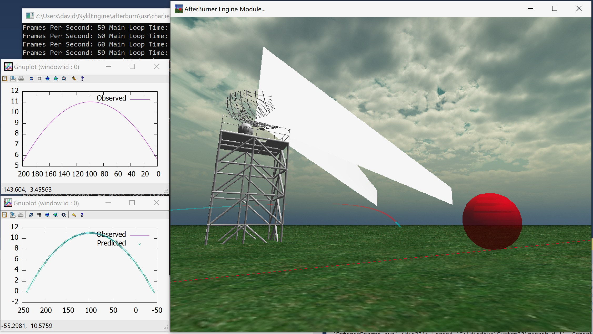
Images of Plots / Performance Analysis
Output is equivalent to solution output
What didn’t work?
PolyFit generates numerical conversion warnings in lu.hpp
When does it work?
Quantitative proof in demonstration
Notes:
Convince me why your system works
When does it fail?
Provide Quantitative evidence
When does it work?
Provide Quantitative evidence

Slide 6
Images of Plots / Performance Analysis
Output is equivalent to solution output
What didn’t work?
PolyFit generates numerical conversion warnings in lu.hpp
When does it work?
Quantitative proof in demonstration
Notes:
Convince me why your system works
When does it fail?
Provide Quantitative evidence
When does it work?
Provide Quantitative evidence

Slide 7
Team Hours and Morale
Lt David Crow: high morale
1 hour: Ribbon implementation
2 hours: Assisting groupmates, cleaning code, testing
2 hours: PolyFit and Gnuplot
Lt Savannah Hyde: medium morale
6 hours: PolyFit implementation
2 hours: Debugging, testing code
Lt Ahmed King: high morale
3 hours: Figuring out how to use Gnuplot (didn’t read your email)
3 hours: Implementing and debugging the plot
Notes:
Capt Student (32 hrs)
Hrs Breakdown
12 hrs Brainstorming/Researching (gnuplot plot design, early prototypes)
5 hrs Implementing Dish Rotation
15 hrs Supporting Data Structure Implementation/Debugging
Biggest Time sinks
Current Morale Status: High / Medium / Low morale

Slide 8
Questions?

Slide 9
Grading
Total 75 / 80 Points
Phase 3 Test / Demo
Missile Trajectory
Radar Properly senses tracked objects
Modifiable Sensor Location
Plotting
Observed Plot
Predicted Plot
Quadratic Root Finding Functionality
Integrating 3rd party code
Required Behavior
GNU Plot does *NOT* block the 3D Virtual World
Can show both plots simultaneously
(No linear interpolation for plotting X pts across x-axis, required in HW3 program description) -5
Software Quality Attributes & Class Design
Class Design
Maintainability
Testability
Usability
Comments
Excellent use of callbacks based on design requirements
Good traceability via Git Logs

